Slide 1
Allocate and Level Project Resources

Slide 2
Importance of Resource Management
The completion of an engineering project at maximum efficiency of time and cost requires the careful scheduling and allocation of available resources.
Manpower, equipment, materials, subcontractors, and information are important project resources that require close management attention.
The supply and availability of these resources can seldom be taken for granted because of seasonal shortages, labor disputes, equipment breakdowns, delayed deliveries, and a host of associated uncertainties.
Money, another project resource that requires close management control during the construction process is discussed fully in separate lectures.

Slide 3
Objective of Resource Planning
The basic objective of resource management is to supply and support field operations with the resources required so that established time objectives can be met and costs can be kept within the budget.

Slide 4
Limitation of CPM
The basic PERT/CPM procedures are limited in the sense that resource availabilities are not considered in the scheduling process. The procedures assume that available resources are unlimited.

Slide 5
How limited resources affect schedule slack
Assume that activities “C” and “G” each require the use of a special piece of equipment, such a hoist crane. But only one crane is available.
3
0
9
9
0
13
C
I
0
0
3
3
6
9
9
4
13
A
0
3
3
3
5
5
5
5
8
13
0
15
15
0
18
18
0
18
D
E
J
K
FINISH
0
0
0
8
2
10
10
3
13
13
2
15
15
3
18
18
0
18
START
0
0
0
5
5
8
F
10
3
13
0
4
5
5
4
9
9
4
14
ES
TF
EF
B
G
H
Activity
4
5
9
9
4
13
13
5
18
LS
D
LF
Resources

Slide 6
How limited resources affect schedule slack
Time | 1 | 2 | 3 | 4 | 5 | 6 | 7 | 8 | 9 | 10 | 11 | 12 | 13 | 14 | 15 | 16 | 17 | 18
A
C |  |  |  | 1 | 1 | 1 | 1 | 1 | 1
I
J
K
B
G |  |  |  |  |  | 1 | 1 | 1 | 1
H
D
E
F
R |  |  |  | 1 | 1 | 2 | 2 | 2 | 2

Slide 7
How limited resources affect schedule slack
Time | 1 | 2 | 3 | 4 | 5 | 6 | 7 | 8 | 9 | 10 | 11 | 12 | 13 | 14 | 15 | 16 | 17 | 18
A
 |  |  | C | 1 | 1 | 1 | 1 | 1 | 1
 |  |  |  |  |  |  |  |  | I
 |  |  |  |  |  |  |  |  |  |  |  |  | J
 |  |  |  |  |  |  |  |  |  |  |  |  |  |  | K
B
 |  |  |  |  | G |  |  |  |  | 1 | 1 | 1 | 1
 |  |  |  |  |  |  |  |  | H
 |  |  | D
 |  |  |  |  | E
 |  |  |  |  | F
R |  |  |  | 1 | 1 | 1 | 1 | 1 | 1 | 1 | 1 | 1 | 1

Slide 8
How limited resources affect schedule slack
The direct result of this resource constraint is that activities “C” and “G” can not be performed simultaneously as indicated by the ES time-only schedule. One or the other of the activities in each pair must be given priority.
In general, the following is true:
Resource constraints reduce the total amount of schedule slack.
Slack depends both upon activity relationships and resource limitations.
The critical path in resource-constrained schedule may not be the same continuous chain (s) of activities as occurring in the unlimited resources schedule.

Slide 9
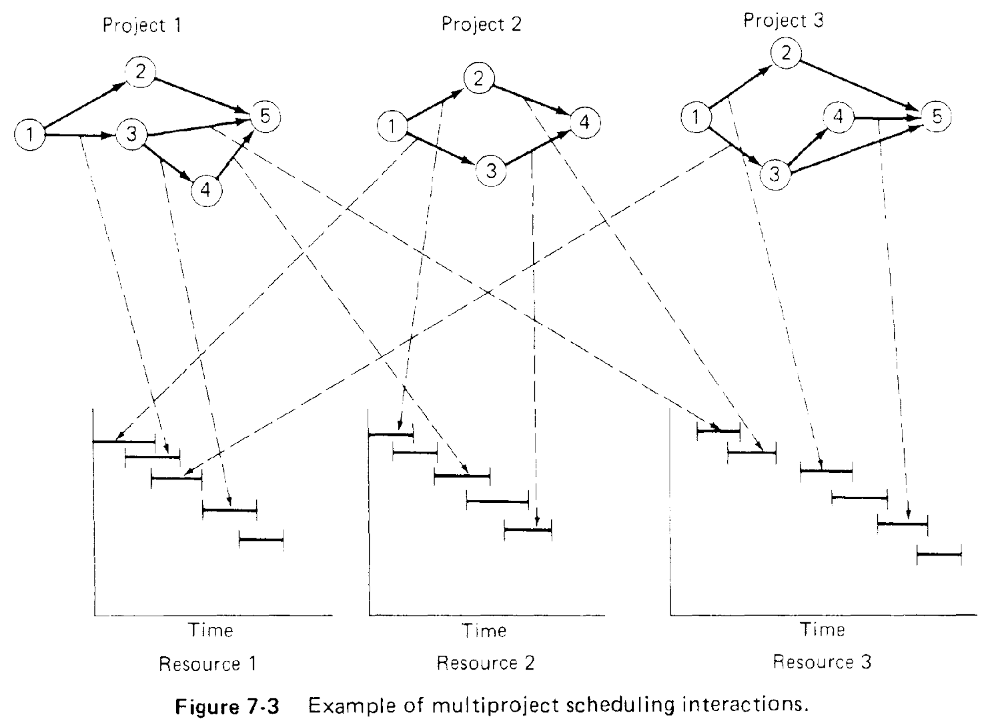

Slide 10
Project Resource Requirement
Project Resource Requirement = Resource Loading Diagram = Resource Histogram and S curve
We need:
Project network.
Resource requirement for each activity.
Bar chart or time-scaled network.
We make:
Resource loading diagram (a diagram that highlights the period-by-period resource implications of a particular project schedule).
Period-by-period total requirements of units of resources.
Cumulative resource requirement curve (S curve).

Slide 11
Resource Loading Diagram
3
0
9
9
0
13
C
I
0
0
3
3
6
9
9
4
13
A
3 R
3 R
0
3
3
3
5
5
5
5
8
13
0
15
15
0
18
18
0
18
3 R
D
E
J
K
FINISH
0
0
0
8
2
10
10
3
13
13
2
15
15
3
18
18
0
18
START
4 R
2 R
4 R
5 R
0 R
0
0
0
5
5
8
0 R
F
10
3
13
0
4
5
5
4
9
1 R
9
4
14
ES
TF
EF
B
G
H
Activity
4
5
9
9
4
13
13
5
18
LS
D
LF
2 R
3 R
2 R
Resource Type R

Slide 12
Resource Loading Diagram based on ES schedule
Time | 1 | 2 | 3 | 4 | 5 | 6 | 7 | 8 | 9 | 10 | 11 | 12 | 13 | 14 | 15 | 16 | 17 | 18
A | 3 | 3 | 3
C |  |  | C | 3 | 3 | 3 | 3 | 3 | 3
I |  |  |  |  |  |  |  |  | I | 3 | 3 | 3 | 3
J |  |  |  |  |  |  |  |  |  |  |  |  | J | 4 | 4
K |  |  |  |  |  |  |  |  |  |  |  |  |  |  | K | 5 | 5 | 5
B | 2 | 2 | 2 | 2 | 2
G |  |  |  |  | G | 3 | 3 | 3 | 3
H |  |  |  |  |  |  |  |  | H | 2 | 2 | 2 | 2 | 2
D |  |  | D | 4 | 4
E |  |  |  |  | E | 2 | 2 | 2
F |  |  |  |  | F | 1 | 1 | 1
Daily R | 5 | 5 | 5 | 9 | 9 | 9 | 9 | 9 | 6 | 5 | 5 | 5 | 5 | 6 | 4 | 5 | 5 | 5
∑R | 5 | 10 | 15 | 24 | 33 | 42 | 51 | 60 | 66 | 71 | 76 | 81 | 86 | 92 | 96 | 101 | 106 | 111
R² | 25 | 25 | 25 | 81 | 81 | 81 | 81 | 81 | 36 | 25 | 25 | 25 | 25 | 36 | 16 | 25 | 25 | 25
10 |  |  |  |  |  |  |  |  |  |  |  |  |  |  |  |  | ∑R² | 743
9
8
7
6
5
4
3 |  |  |  | Resource Loading Diagram = Resource Histogram
2
1

Slide 13
Resource Loading Diagram based on LS schedule
Time | 1 | 2 | 3 | 4 | 5 | 6 | 7 | 8 | 9 | 10 | 11 | 12 | 13 | 14 | 15 | 16 | 17 | 18
A | 3 | 3 | 3
 |  |  | C | 3 | 3 | 3 | 3 | 3 | 3
 |  |  |  |  |  |  |  |  | I | 3 | 3 | 3 | 3
 |  |  |  |  |  |  |  |  |  |  |  |  | J | 4 | 4
 |  |  |  |  |  |  |  |  |  |  |  |  |  |  | K | 5 | 5 | 5
 |  |  |  | B | 2 | 2 | 2 | 2 | 2
 |  |  |  |  |  |  |  |  | G | 3 | 3 | 3 | 3
 |  |  |  |  |  |  |  |  |  |  |  |  | H | 2 | 2 | 2 | 2 | 2
 |  |  |  |  |  |  |  | D | 4 | 4
 |  |  |  |  |  |  |  |  |  | E | 2 | 2 | 2
 |  |  |  |  |  |  |  |  |  | F | 1 | 1 | 1
R | 3 | 3 | 3 | 3 | 5 | 5 | 5 | 5 | 9 | 10 | 9 | 9 | 9 | 6 | 6 | 7 | 7 | 7
∑R | 3 | 6 | 9 | 12 | 17 | 22 | 27 | 32 | 41 | 51 | 60 | 69 | 78 | 84 | 90 | 97 | 104 | 111
R² | 9 | 9 | 9 | 9 | 25 | 25 | 25 | 25 | 81 | 100 | 81 | 81 | 81 | 36 | 36 | 49 | 49 | 49
10 |  |  |  |  |  |  |  |  |  |  |  |  |  |  |  |  | ∑R² | 779
9
8
7
6
5
4
3
2
1 |  |  |  |  |  | Resource Loading Diagram = Resource Histogram

Slide 14
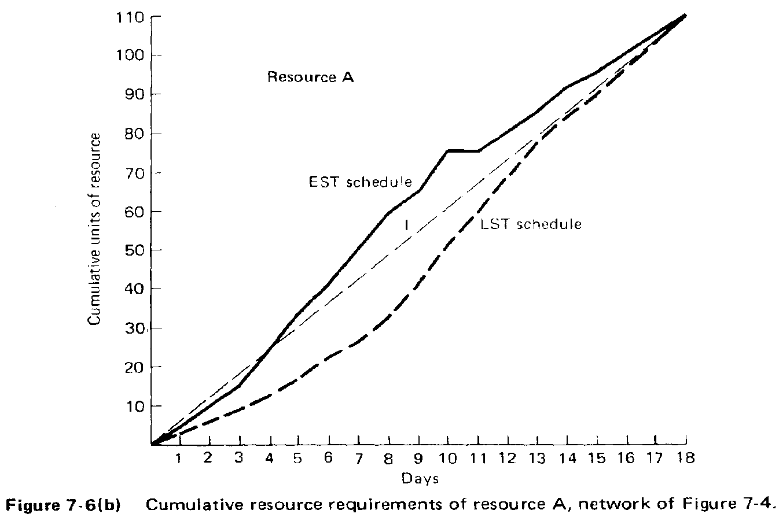
Cumulative Resource Requirement Curve
Cumulative resource requirement curve (S-curve) may be used for:
Planning and Control of progress
Preliminary resource allocation

Slide 15
Resource Constraint “Criticality”
Average Daily Requirement
Avg. daily requirement = Total unit of resources / Project duration
Avg. daily requirement = 111 / 18 = 6.2 units/day
Suppose the analyzed resource is available at a maximum level of 7 units/day.
∴ 126 units could be expended over the 18-day project duration, which is more than 111 units. ∴ Project delay is unlikely.
Resource Criticality Index
Criticality index= avg. daily units req’d / max. am’t avail. Daily
∴ Criticality index = 6.2/7.0 = 0.88 < 1 ∴ project on time
Suppose the analyzed resource is available at a maximum level of 6 units/day.
∴ Criticality index = 6.2/6.0 = 1.03 > 1 ∴ project will delay
In 18 days a total of only 108 units are will be expended (< 111 units), leaving some work unfinished and thus requiring an extension of the project beyond 18 days.

Slide 16
Resource Constraint “Criticality”
Resource Criticality Index
Values of resource criticality index significantly below 1.0 typically are associated with non-constraining resources, while values around and above 1.0 indicate that project delays beyond the original critical path duration will be encountered.
Higher values of resource criticality index are associated with the most critical (i.e., most tightly constrained) resources.

Slide 17
Resource Leveling and Allocation
Scheduling Procedures for Dealing with Resource Constraints
Resource Leveling (Resource Smoothing)
Fixed-limits Resource Scheduling
(Limited Resource Allocation)

Slide 18
Resource Leveling (Smoothing)
Main Aspects
Sufficient total resources are available
Project must be completed by a specified due date
It is desirable or necessary to reduce the amount of variability (peak and valley) in the pattern of resource usage over the project duration.
The objective is to level, as much as possible, the demand for each specific resource during the life of the project.
Project duration is not allowed to increase in this case.

Slide 19
Fixed Resource Limits Scheduling
Main Aspects
Also often called constrained-resource scheduling, or limited resource allocation
Much more common
There are definite limitations on the amount of resources available to carry out the project (or projects) under consideration.
Project duration may increase beyond the initial duration determined by the usual “time only” CPM calculations.
The scheduling objective is equivalent to minimizing the duration of the project (or projects) being scheduled, subject to stated constraints on available resources.

Slide 20
Basic General Approach
The basic general approach followed in both resource leveling and fixed resource limits scheduling is similar:
Set activity priorities according to some criterion and then
Schedule activities in the order determined, as soon as their predecessors are completed and adequate resources are available

Slide 21
Resource Leveling (Smoothing)
Resource leveling techniques provide a means of distributing resource usage over time to minimize the period-by-period variations in manpower, equipment, or money expended.
The essential idea of resource leveling centers about the rescheduling of activities within the limits of available float to achieve better distribution of resource usage.
A systematic procedure for leveling resources was developed by Burgess.
Burgess method utilized a simple measure of effectiveness given by the sum of the squares of the resource requirements for each “day” (period) in the project schedule.

Slide 22
Resource Leveling (Smoothing)
While the sum of daily resource requirements over the project duration is constant for all complete schedule, the sum of the squares of the daily requirements decreases as the peaks and valleys are leveled.
The measure of effectiveness reaches a minimum for a schedule that is level and equals
= (Average daily requirement)² * Project duration
= R² * Project duration
Resource Unit
Average daily resource requirement (R)
Time

Slide 23
Burgess Leveling Procedure
Step 1. List the project activities in order of precedence. Add to this listing the duration, early start, and float (slack) values for each activity.
Step 2. Starting with the last activity, schedule it period by period to give the lowest sum of squares of resource requirements for each time unit. If more than one schedule gives the same total sum of squares, then schedule the activity as late as possible to get as much slack as possible in all preceding activities.
Step 3. Holding the last activity fixed, repeat Step 2 on the next to the last activity in the network, taking advantage of any slack that may have been made available to it by the rescheduling in Step 2.
Step 4. Continue Step 3 until the first activity in the list has been considered; this completes the first rescheduling cycle.

Slide 24
Burgess Leveling Procedure
Step 5. Carry out additional rescheduling cycles by repeating Steps 2 through 4 until no further reduction in the total sum of squares of resource requirements is possible, noting that only movement of an activity to the right (schedule later) is permissible under this scheme.
Step 6. If this resource is particularly critical, repeat Steps 1 through 5 on a different ordering of the activities. which, of course, must still list the activities in order of precedence.
Step 7. Choose the best schedule of those obtained in Steps 5 and 6.
Step 8. Make final adjustments to the schedule chosen in Step 7, taking into account factors not considered in the basic scheduling procedure.

Slide 25
Application of Burgess Procedure
Time | 1 | 2 | 3 | 4 | 5 | 6 | 7 | 8 | 9 | 10 | 11 | 12 | 13 | 14 | 15 | 16 | 17 | 18
A | 3 | 3 | 3
C |  |  | C | 3 | 3 | 3 | 3 | 3 | 3
I |  |  |  |  |  |  |  |  | I | 3 | 3 | 3 | 3
J |  |  |  |  |  |  |  |  |  |  |  |  | J | 4 | 4
K |  |  |  |  |  |  |  |  |  |  |  |  |  |  | K | 5 | 5 | 5
B | 2 | 2 | 2 | 2 | 2
G |  |  |  |  | G | 3 | 3 | 3 | 3
H |  |  |  |  |  |  |  |  | H | 2 | 2 | 2 | 2 | 2
D |  |  | D | 4 | 4
E |  |  |  |  | E | 2 | 2 | 2
F |  |  |  |  | F | 1 | 1 | 1
Daily R | 5 | 5 | 5 | 9 | 9 | 9 | 9 | 9 | 6 | 5 | 5 | 5 | 5 | 6 | 4 | 5 | 5 | 5
∑R | 5 | 10 | 15 | 24 | 33 | 42 | 51 | 60 | 66 | 71 | 76 | 81 | 86 | 92 | 96 | 101 | 106 | 111
∑R² | 25 | 50 | 75 | 156 | 237 | 318 | 399 | 480 | 516 | 541 | 566 | 591 | 616 | 652 | 668 | 693 | 718 | 743
10
9
8
7
6
5
4
3 |  |  |  | Resource Loading Diagram = Resource Histogram
2
1

Slide 26
Application of Burgess Procedure
Time | 1 | 2 | 3 | 4 | 5 | 6 | 7 | 8 | 9 | 10 | 11 | 12 | 13 | 14 | 15 | 16 | 17 | 18
A | 3 | 3 | 3
 |  |  | C | 3 | 3 | 3 | 3 | 3 | 3
 |  |  |  |  |  |  |  |  | I | 3 | 3 | 3 | 3
 |  |  |  |  |  |  |  |  |  |  |  |  | J | 4 | 4
 |  |  |  |  |  |  |  |  |  |  |  |  |  |  | K | 5 | 5 | 5
B | 2 | 2 | 2 | 2 | 2
 |  |  |  |  | G | 3 | 3 | 3 | 3
 |  |  |  |  |  |  |  |  | H |  | 2 | 2 | 2 | 2 | 2
 |  |  | D | 4 | 4
 |  |  |  |  | E | 2 | 2 | 2
 |  |  |  |  | F | 1 | 1 | 1
R | 5 | 5 | 5 | 9 | 9 | 9 | 9 | 9 | 6 | 3 | 5 | 5 | 5 | 6 | 6 | 5 | 5 | 5
R² | 25 | 25 | 25 | 81 | 81 | 81 | 81 | 81 | 36 | 9 | 25 | 25 | 25 | 36 | 36 | 25 | 25 | 25
Delay activity “H” one period ∴ ∑ R² = 747

Slide 27
Application of Burgess Procedure
Time | 1 | 2 | 3 | 4 | 5 | 6 | 7 | 8 | 9 | 10 | 11 | 12 | 13 | 14 | 15 | 16 | 17 | 18
A | 3 | 3 | 3
 |  |  | C | 3 | 3 | 3 | 3 | 3 | 3
 |  |  |  |  |  |  |  |  | I | 3 | 3 | 3 | 3
 |  |  |  |  |  |  |  |  |  |  |  |  | J | 4 | 4
 |  |  |  |  |  |  |  |  |  |  |  |  |  |  | K | 5 | 5 | 5
B | 2 | 2 | 2 | 2 | 2
 |  |  |  |  | G | 3 | 3 | 3 | 3
 |  |  |  |  |  |  |  |  | H |  |  | 2 | 2 | 2 | 2 | 2
 |  |  | D | 4 | 4
 |  |  |  |  | E | 2 | 2 | 2
 |  |  |  |  | F | 1 | 1 | 1
R | 5 | 5 | 5 | 9 | 9 | 9 | 9 | 9 | 6 | 3 | 3 | 5 | 5 | 6 | 6 | 7 | 5 | 5
R² | 25 | 25 | 25 | 81 | 81 | 81 | 81 | 81 | 36 | 9 | 9 | 25 | 25 | 36 | 36 | 49 | 25 | 25
Delay activity “H” 2 periods ∴ ∑ R² = 755

Slide 28
Application of Burgess Procedure
Time | 1 | 2 | 3 | 4 | 5 | 6 | 7 | 8 | 9 | 10 | 11 | 12 | 13 | 14 | 15 | 16 | 17 | 18
A | 3 | 3 | 3
 |  |  | C | 3 | 3 | 3 | 3 | 3 | 3
 |  |  |  |  |  |  |  |  | I | 3 | 3 | 3 | 3
 |  |  |  |  |  |  |  |  |  |  |  |  | J | 4 | 4
 |  |  |  |  |  |  |  |  |  |  |  |  |  |  | K | 5 | 5 | 5
B | 2 | 2 | 2 | 2 | 2
 |  |  |  |  | G | 3 | 3 | 3 | 3
 |  |  |  |  |  |  |  |  | H |  |  |  | 2 | 2 | 2 | 2 | 2
 |  |  | D | 4 | 4
 |  |  |  |  | E | 2 | 2 | 2
 |  |  |  |  | F | 1 | 1 | 1
R | 5 | 5 | 5 | 9 | 9 | 9 | 9 | 9 | 6 | 3 | 3 | 3 | 5 | 6 | 6 | 7 | 7 | 5
R² | 25 | 25 | 25 | 81 | 81 | 81 | 81 | 81 | 36 | 9 | 9 | 9 | 25 | 36 | 36 | 49 | 49 | 25
Delay activity “H” 3 periods ∴ ∑ R² = 763

Slide 29
Application of Burgess Procedure
Time | 1 | 2 | 3 | 4 | 5 | 6 | 7 | 8 | 9 | 10 | 11 | 12 | 13 | 14 | 15 | 16 | 17 | 18
A | 3 | 3 | 3
 |  |  | C | 3 | 3 | 3 | 3 | 3 | 3
 |  |  |  |  |  |  |  |  | I | 3 | 3 | 3 | 3
 |  |  |  |  |  |  |  |  |  |  |  |  | J | 4 | 4
 |  |  |  |  |  |  |  |  |  |  |  |  |  |  | K | 5 | 5 | 5
B | 2 | 2 | 2 | 2 | 2
 |  |  |  |  | G | 3 | 3 | 3 | 3
 |  |  |  |  |  |  |  |  | H |  |  |  |  | 2 | 2 | 2 | 2 | 2
 |  |  | D | 4 | 4
 |  |  |  |  | E | 2 | 2 | 2
 |  |  |  |  | F | 1 | 1 | 1
R | 5 | 5 | 5 | 9 | 9 | 9 | 9 | 9 | 6 | 3 | 3 | 3 | 3 | 6 | 6 | 7 | 7 | 7
R² | 25 | 25 | 25 | 81 | 81 | 81 | 81 | 81 | 36 | 9 | 9 | 9 | 9 | 36 | 36 | 49 | 49 | 49
Delay activity “H” 4 periods ∴ ∑ R² = 771

Slide 30
Application of Burgess Procedure
Time | 1 | 2 | 3 | 4 | 5 | 6 | 7 | 8 | 9 | 10 | 11 | 12 | 13 | 14 | 15 | 16 | 17 | 18
A | 3 | 3 | 3
 |  |  | C | 3 | 3 | 3 | 3 | 3 | 3
 |  |  |  |  |  |  |  |  | I | 3 | 3 | 3 | 3
 |  |  |  |  |  |  |  |  |  |  |  |  | J | 4 | 4
 |  |  |  |  |  |  |  |  |  |  |  |  |  |  | K | 5 | 5 | 5
B | 2 | 2 | 2 | 2 | 2
 |  |  |  |  | G | 3 | 3 | 3 | 3
 |  |  |  |  |  |  |  |  | H |  | 2 | 2 | 2 | 2 | 2
 |  |  | D | 4 | 4
 |  |  |  |  | E | 2 | 2 | 2
 |  |  |  |  | F | 1 | 1 | 1
R | 5 | 5 | 5 | 9 | 9 | 9 | 9 | 9 | 6 | 3 | 5 | 5 | 5 | 6 | 6 | 5 | 5 | 5
R² | 25 | 25 | 25 | 81 | 81 | 81 | 81 | 81 | 36 | 9 | 25 | 25 | 25 | 36 | 36 | 25 | 25 | 25
The result = Delay activity “H” one period ∴ ∑ R² = 747

Slide 31
Application of Burgess Procedure
Time | 1 | 2 | 3 | 4 | 5 | 6 | 7 | 8 | 9 | 10 | 11 | 12 | 13 | 14 | 15 | 16 | 17 | 18
A | 3 | 3 | 3
 |  |  | C | 3 | 3 | 3 | 3 | 3 | 3
 |  |  |  |  |  |  |  |  | I | 3 | 3 | 3 | 3
 |  |  |  |  |  |  |  |  |  |  |  |  | J | 4 | 4
 |  |  |  |  |  |  |  |  |  |  |  |  |  |  | K | 5 | 5 | 5
B | 2 | 2 | 2 | 2 | 2
 |  |  |  |  | G |  | 3 | 3 | 3 | 3
 |  |  |  |  |  |  |  |  | H |  | 2 | 2 | 2 | 2 | 2
 |  |  | D | 4 | 4
 |  |  |  |  | E | 2 | 2 | 2
 |  |  |  |  | F | 1 | 1 | 1
R | 5 | 5 | 5 | 9 | 9 | 6 | 9 | 9 | 6 | 6 | 5 | 5 | 5 | 6 | 6 | 5 | 5 | 5
R² | 25 | 25 | 25 | 81 | 81 | 36 | 81 | 81 | 36 | 36 | 25 | 25 | 25 | 36 | 36 | 25 | 25 | 25
Delay activity “H” one period & Delay activity “G” one period ∴ ∑ R² = 729

Slide 32
Application of Burgess Procedure
Time | 1 | 2 | 3 | 4 | 5 | 6 | 7 | 8 | 9 | 10 | 11 | 12 | 13 | 14 | 15 | 16 | 17 | 18
A | 3 | 3 | 3
 |  |  | C | 3 | 3 | 3 | 3 | 3 | 3
 |  |  |  |  |  |  |  |  | I | 3 | 3 | 3 | 3
 |  |  |  |  |  |  |  |  |  |  |  |  | J | 4 | 4
 |  |  |  |  |  |  |  |  |  |  |  |  |  |  | K | 5 | 5 | 5
B | 2 | 2 | 2 | 2 | 2
 |  |  |  |  | G |  | 3 | 3 | 3 | 3
 |  |  |  |  |  |  |  |  | H |  | 2 | 2 | 2 | 2 | 2
 |  |  | D |  |  | 4 | 4
 |  |  |  |  | E |  |  |  |  |  | 2 | 2 | 2
 |  |  |  |  | F |  |  | 1 | 1 | 1
R | 5 | 5 | 5 | 5 | 5 | 7 | 10 | 7 | 7 | 7 | 7 | 7 | 7 | 6 | 6 | 5 | 5 | 5
R² | 25 | 25 | 25 | 25 | 25 | 49 | 100 | 49 | 49 | 49 | 49 | 49 | 49 | 36 | 36 | 25 | 25 | 25
Delay activity “H” 1 period, Delay activity “G” 1 period, Delay activity “F” 2 periods, Delay activity “E” 5 periods, and Delay activity “D” 2 periods ∴ ∑ R² = 715
∑ R² = 715

Slide 33
Application of Burgess Procedure
Sequence of major moves of the first rescheduling cycle:
Delay activity “H” one period ∴ ∑ R² = 747
Delay activity “G” one period ∴ ∑ R² = 729
Delay activity “F” two periods ∴ ∑ R² = 727
Delay activity “E” five periods ∴ ∑ R² = 723
Delay activity “D” two periods ∴ ∑ R² = 715

Slide 34
Estimated method
Step 1: Draw the network in a time scaled diagram using the early start schedule method.
Step 2: Perform resource loading for the activities and calculate the total number of resources at each period.
Step 3: Reschedule non-critical activities to reduce peaks and to smooth resource usage in the resource loading chart in order to minimize SUM Y_{i}², where Y_{i} is the number of resource usage in the resource loading chart.
Step 4: Continue Step 3 until you reach the schedule of having minimum value of SUM Y_{i}².

Slide 35
Resource Leveling within the limits of available Floats
Time | 1 | 2 | 3 | 4 | 5 | 6 | 7 | 8 | 9 | 10 | 11 | 12 | 13 | 14 | 15 | 16 | 17 | 18
A | 3 | 3 | 3
C |  |  | C | 3 | 3 | 3 | 3 | 3 | 3
I |  |  |  |  |  |  |  |  | I | 3 | 3 | 3 | 3
J |  |  |  |  |  |  |  |  |  |  |  |  | J | 4 | 4
K |  |  |  |  |  |  |  |  |  |  |  |  |  |  | K | 5 | 5 | 5
B | 2 | 2 | 2 | 2 | 2
G |  |  |  |  | G | 3 | 3 | 3 | 3
H |  |  |  |  |  |  |  |  | H | 2 | 2 | 2 | 2 | 2
D |  |  | D | 4 | 4
E |  |  |  |  | E | 2 | 2 | 2
F |  |  |  |  | F | 1 | 1 | 1
Daily R | 5 | 5 | 5 | 9 | 9 | 9 | 9 | 9 | 6 | 5 | 5 | 5 | 5 | 6 | 4 | 5 | 5 | 5
∑R | 5 | 10 | 15 | 24 | 33 | 42 | 51 | 60 | 66 | 71 | 76 | 81 | 86 | 92 | 96 | 101 | 106 | 111
∑R² | 25 | 50 | 75 | 156 | 237 | 318 | 399 | 480 | 516 | 541 | 566 | 591 | 616 | 652 | 668 | 693 | 718 | 743
10
9
8
7
6
5
4
3 |  |  |  | Resource Loading Diagram = Resource Histogram
2
1

Slide 36
Resource Leveling within the limits of available Floats
Time | 1 | 2 | 3 | 4 | 5 | 6 | 7 | 8 | 9 | 10 | 11 | 12 | 13 | 14 | 15 | 16 | 17 | 18
A | 3 | 3 | 3
 |  |  | C | 3 | 3 | 3 | 3 | 3 | 3
 |  |  |  |  |  |  |  |  | I | 3 | 3 | 3 | 3
 |  |  |  |  |  |  |  |  |  |  |  |  | J | 4 | 4
 |  |  |  |  |  |  |  |  |  |  |  |  |  |  | K | 5 | 5 | 5
B | 2 | 2 | 2 | 2 | 2
 |  |  |  |  |  |  |  |  | G | 3 | 3 | 3 | 3
 |  |  |  |  |  |  |  |  |  |  |  |  | H | 2 | 2 | 2 | 2 | 2
 |  |  | D | 4 | 4
 |  |  |  |  | E | 2 | 2 | 2
 |  |  |  |  | F | 1 | 1 | 1
R | 5 | 5 | 5 | 9 | 9 | 6 | 6 | 6 | 3 | 6 | 6 | 6 | 6 | 6 | 6 | 7 | 7 | 7
R² | 25 | 25 | 25 | 81 | 81 | 36 | 36 | 36 | 9 | 36 | 36 | 36 | 36 | 36 | 36 | 49 | 49 | 49
Delay activity “H” 4 periods & Delay activity “G” 4 period ∴ ∑ R² = 717

Slide 37
Resource Leveling within the limits of available Floats
Time | 1 | 2 | 3 | 4 | 5 | 6 | 7 | 8 | 9 | 10 | 11 | 12 | 13 | 14 | 15 | 16 | 17 | 18
A | 3 | 3 | 3
 |  |  | C | 3 | 3 | 3 | 3 | 3 | 3
 |  |  |  |  |  |  |  |  | I | 3 | 3 | 3 | 3
 |  |  |  |  |  |  |  |  |  |  |  |  | J | 4 | 4
 |  |  |  |  |  |  |  |  |  |  |  |  |  |  | K | 5 | 5 | 5
B | 2 | 2 | 2 | 2 | 2
 |  |  |  |  |  |  |  |  | G | 3 | 3 | 3 | 3
 |  |  |  |  |  |  |  |  |  |  |  |  | H | 2 | 2 | 2 | 2 | 2
 |  |  |  |  | D | 4 | 4
 |  |  |  |  |  |  | E | 2 | 2 | 2
 |  |  |  |  |  |  | F | 1 | 1 | 1
R | 5 | 5 | 5 | 5 | 5 | 7 | 7 | 6 | 6 | 9 | 6 | 6 | 6 | 6 | 6 | 7 | 7 | 7
R² | 25 | 25 | 25 | 25 | 25 | 49 | 49 | 36 | 36 | 81 | 36 | 36 | 36 | 36 | 36 | 49 | 49 | 49
Delay activity “H” 4 periods, Delay activity “G” 4 periods, Delay activity “E” 2 periods, Delay activity “F” 2 periods, and Delay activity “D” 2 periods ∴ ∑ R² = 703

Slide 38
Resource Leveling within the limits of available Floats
Time | 1 | 2 | 3 | 4 | 5 | 6 | 7 | 8 | 9 | 10 | 11 | 12 | 13 | 14 | 15 | 16 | 17 | 18
A | 3 | 3 | 3
 |  |  | C | 3 | 3 | 3 | 3 | 3 | 3
 |  |  |  |  |  |  |  |  | I | 3 | 3 | 3 | 3
 |  |  |  |  |  |  |  |  |  |  |  |  | J | 4 | 4
 |  |  |  |  |  |  |  |  |  |  |  |  |  |  | K | 5 | 5 | 5
B | 2 | 2 | 2 | 2 | 2
 |  |  |  |  |  |  |  |  | G | 3 | 3 | 3 | 3
 |  |  |  |  |  |  |  |  |  |  |  |  | H | 2 | 2 | 2 | 2 | 2
 |  |  |  |  | D | 4 | 4
 |  |  |  |  |  |  | E | 2 | 2 | 2
 |  |  |  |  |  |  |  |  |  | F | 1 | 1 | 1
R | 5 | 5 | 5 | 5 | 5 | 7 | 7 | 5 | 5 | 8 | 7 | 7 | 7 | 6 | 6 | 7 | 7 | 7
∑R² | 25 | 50 | 75 | 100 | 125 | 174 | 223 | 248 | 273 | 337 | 386 | 435 | 484 | 520 | 556 | 605 | 654 | 703
Delay activity “H” 4 periods, Delay activity “G” 4 periods, Delay activity “F” 5 periods, Delay activity “E” 2 periods, and Delay activity “D” 2 periods ∴ ∑ R² = 703

Slide 39
Limited Resource Allocation
START
calculate initial early start (ES) and late start (LS) time for each activity in the project, and set time now equal to 0, i.e., T = 0.
Determine the initial eligible activity set (EAS), i.e., those activities with all predecessor activities scheduled.
From among the members of the current EAS, determine the ordered scheduling set (OSS) of activities, i.e., activities with all predecessor activities completed, ordered according to LS with smallest values first and within this characteristic, according to least activity duration first.
Consider the activities in OSS in the order listed and schedule those activities for which sufficient resources are available for the duration of the activity. As activities are scheduled update the level of resources available, and update the members of EAS.
Have all activities been scheduled, i.e., is EAS an empty set?
Yes
STOP
No
Set T_{new}= T_{old} + 1 and updated EAS.

Slide 40
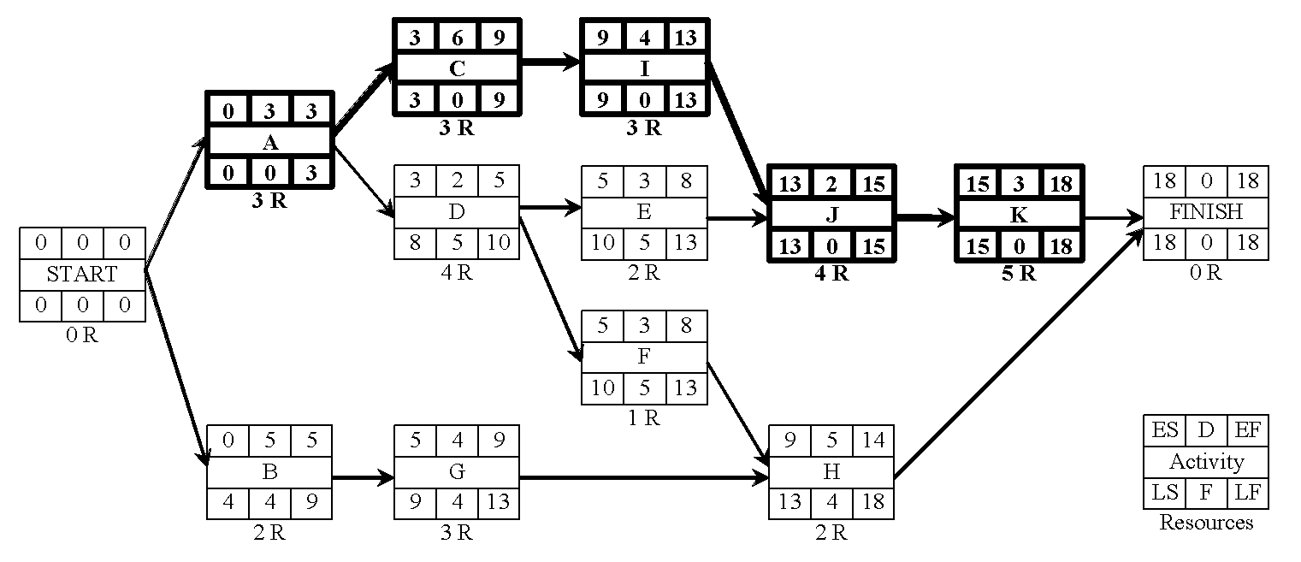
Example
The work of a small engineering project is planned according to the AON shown below. The labour requirement of each activity is shown below each activity box. What will be the minimum contract duration if no more than 6 labours can be made available for the work and if it is assumed that having started an activity it must be completed without a break?

Slide 41
EAS
OSS
Day | 1 | 2 | 3 | 4 | 5 | 6 | 7 | 8 | 9 | 10 | 11 | 12 | 13 | 14 | 15 | 16 | 17 | 18 | 19 | 20 | 21 | 22 | 23

Slide 42
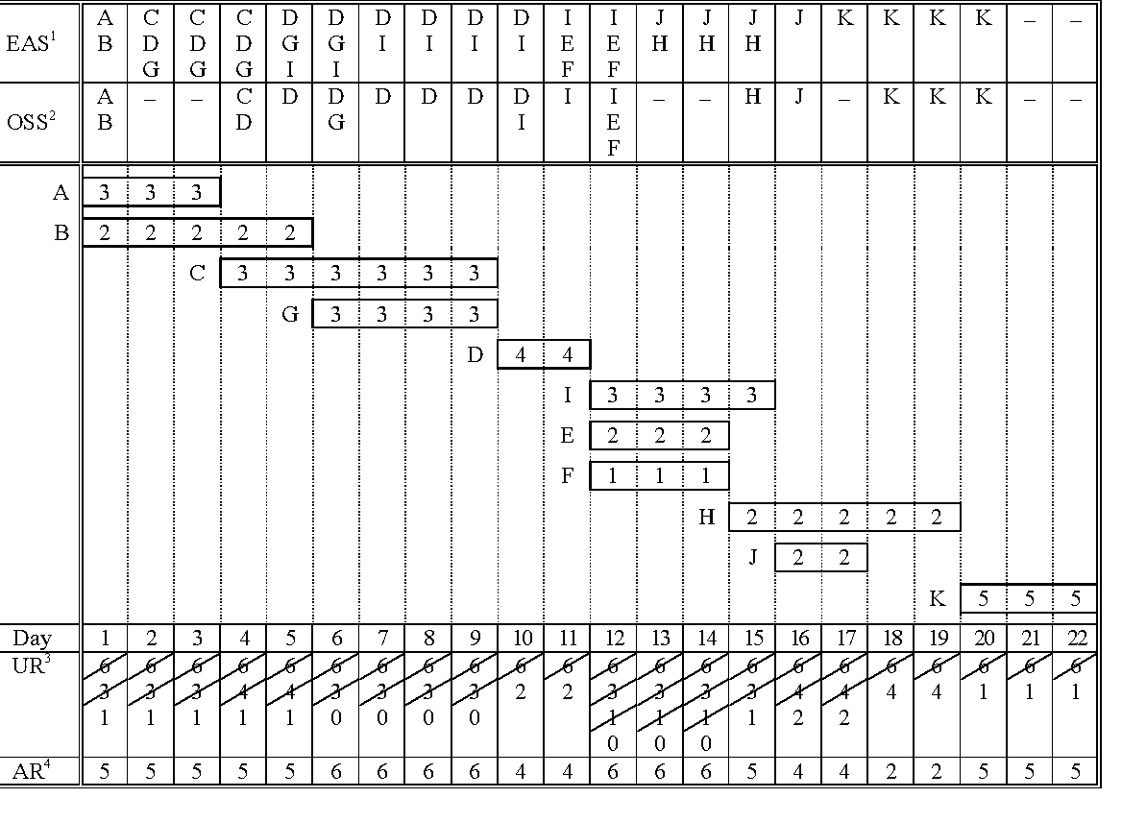

Slide 43
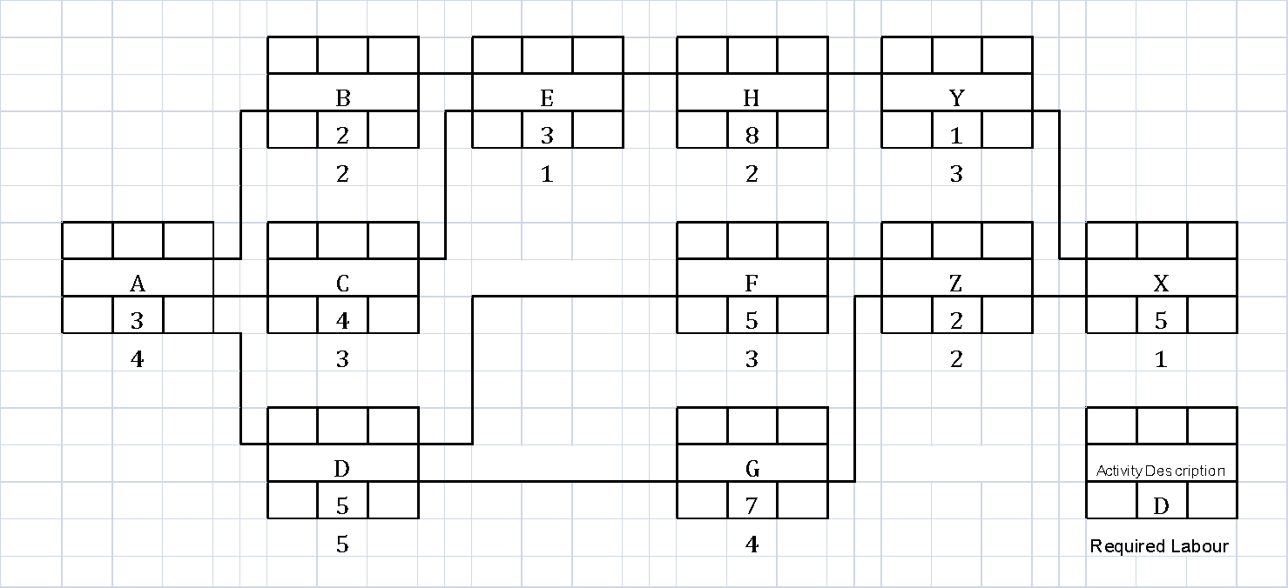
Example
The work of a small engineering project is planned according to the AON shown below. The labour requirement of each activity is shown below each activity box. What will be the minimum contract duration if no more than 6 labours can be made available for the work and if it is assumed that having started an activity it must be completed without a break?

Slide 44
EAS
OSS
Day | 1 | 2 | 3 | 4 | 5 | 6 | 7 | 8 | 9 | 10 | 11 | 12 | 13 | 14 | 15 | 16 | 17 | 18 | 19 | 20 | 21 | 22 | 23 | 24 | 25 | 26 | 27 | 28 | 29 | 30 | 31

Slide 45
Example
T | 1 | 2 | 3 | 4 | 5 | 6 | 7 | 8 | 9 | 10 | 11 | 12 | 13 | 14 | 15 | 16 | 17 | 18 | 19 | 20 | 21 | 22 | 23 | 24 | 25 | 26 | 27 | 28 | 29 | 30 | 31
 | A
 | 4 | 4 | 4 | C
 |  |  |  | 3 | 3 | 3 | 3
 |  |  |  | B
 |  |  |  | 2 | 2 |  |  | D
 |  |  |  |  |  |  |  | 5 | 5 | 5 | 5 | 5
 |  |  |  |  |  |  |  | E
 |  |  |  |  |  |  |  | 1 | 1 | 1 |  |  | G
 |  |  |  |  |  |  |  |  |  |  |  |  | 4 | 4 | 4 | 4 | 4 | 4 | 4
 |  |  |  |  |  |  |  |  |  |  |  |  | H
 |  |  |  |  |  |  |  |  |  |  |  |  | 2 | 2 | 2 | 2 | 2 | 2 | 2 | 2
 |  |  |  |  |  |  |  |  |  |  |  |  |  |  |  |  |  |  |  | F
 |  |  |  |  |  |  |  |  |  |  |  |  |  |  |  |  |  |  |  | 3 | 3 | 3 | 3 | 3
 |  |  |  |  |  |  |  |  |  |  |  |  |  |  |  |  |  |  |  |  | Y
 |  |  |  |  |  |  |  |  |  |  |  |  |  |  |  |  |  |  |  |  | 3 |  |  |  | Z
 |  |  |  |  |  |  |  |  |  |  |  |  |  |  |  |  |  |  |  |  |  |  |  |  | 2 | 2
 |  |  |  |  |  |  |  |  |  |  |  |  |  |  |  |  |  |  |  |  |  |  |  |  |  |  | X
 |  |  |  |  |  |  |  |  |  |  |  |  |  |  |  |  |  |  |  |  |  |  |  |  |  |  | 1 | 1 | 1 | 1 | 1
R | 4 | 4 | 4 | 5 | 5 | 3 | 3 | 6 | 6 | 6 | 5 | 5 | 6 | 6 | 6 | 6 | 6 | 6 | 6 | 5 | 6 | 3 | 3 | 3 | 2 | 2 | 1 | 1 | 1 | 1 | 1

Slide 46
Example
Step 1: T = 1 ES ≤ 1 E.A.S. {A} O.S.S. {A} |  | Step 5: T = 20 ES ≤ 20 E.A.S. {F} O.S.S. {F}
Step 2: T = 4 ES ≤ 4 E.A.S. {B, C, D} LS 6, 4, 6 D 2, 4, 5 O.S.S. {C, B, D} |  | Step 6: T = 21 ES ≤ 21 E.A.S. {Y} O.S.S. {Y}
Step 3: T = 8 ES ≤ 8 E.A.S. {E, D} LS 8, 6 O.S.S. {D, E} |  | Step 7: T = 25 ES ≤ 25 E.A.S. {Z} O.S.S. {Z}
Step 4: T = 13 ES ≤ 13 E.A.S. {H, F, G} LS 11,13, 11 D 8, 5, 7 O.S.S. {G, H, F} |  | Step 8:T = 27 ES ≤ 27 E.A.S. {Y} O.S.S. {Y}

